Slide 1
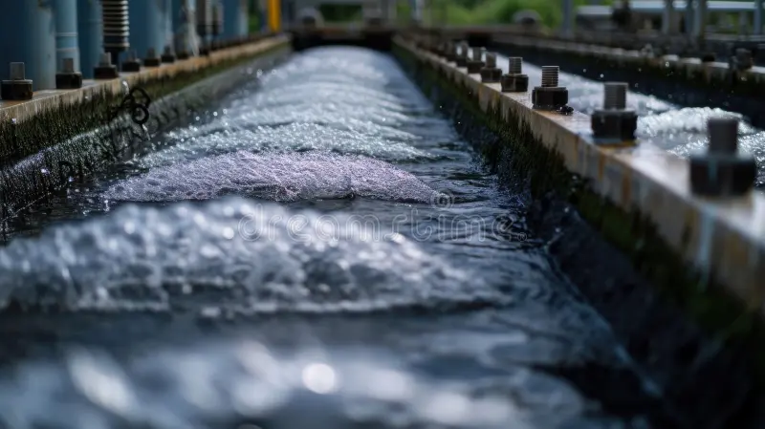
SAFEWATER INNOVATION
NIKITA SIRSE

Slide 2



Introduction
Revolutionizing water treatment solutions sustainable, cost-effective, and technology-driven approach.
To deliver innovative, eco-friendly, and affordable water treatment solutions that ensure clean and safe water for all, enhancing health and sustainability globally.
To become global leader in advanced water treatment technologies by integrating smart technology and sustainable practices, ensuring future where clean water is accessible to everyone.

Slide 3
Roles of Business Analyst
Requirement gathering
Stakeholder Communication
Documentation
Process Analysis
Performance Monitoring
Testing & validation
Risk Management
Business Analyst Roles

Slide 4

Develop an Efficient Wastewater Treatment Plant
Regulatory Compliance
Technology Integration
Cost Effective Operation
Timely Projected delivery
Sustainable scalable solutions
Project Objectives

Slide 5

Agile Approach & Methodology
a set of principles and practices that promote iterative development, collaboration, and flexibility in project management.
Scrum framework

Slide 6
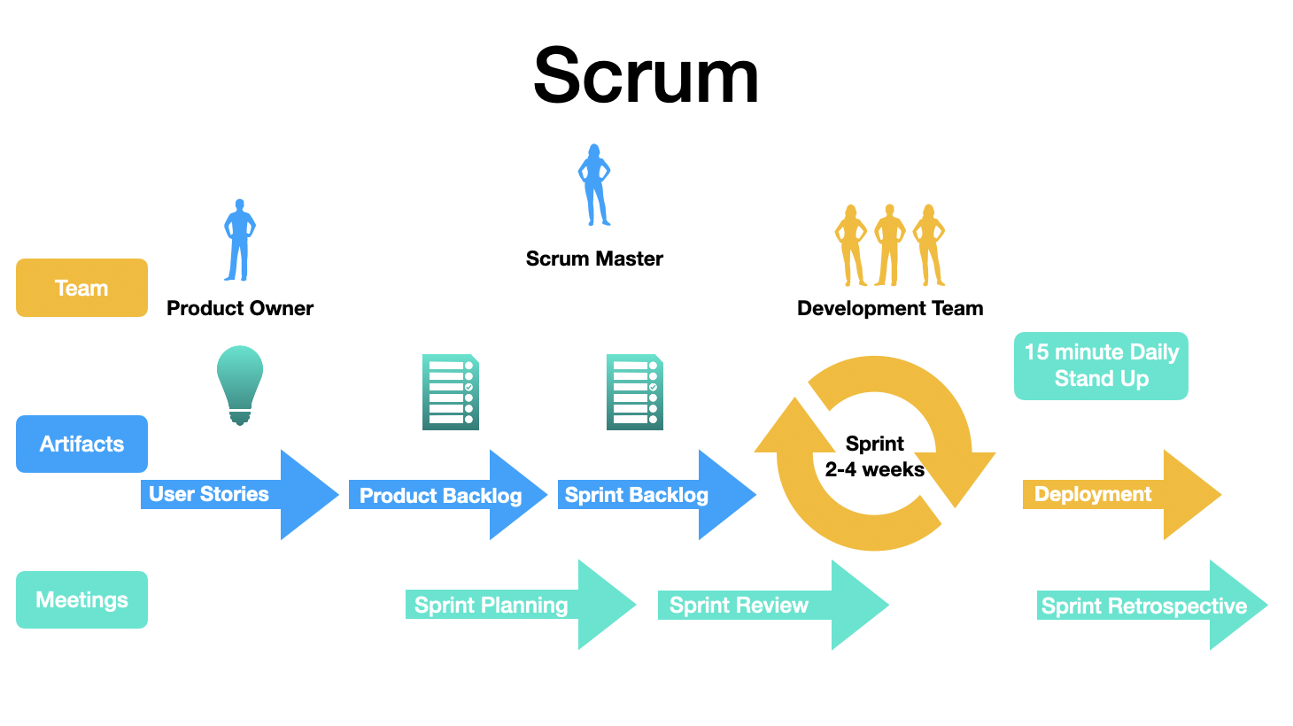

Slide 7


Product Backlog
Benefits
Transparency
Focus
Adaptability
User stories
High Priority
Features
Product Backlog Item
Bug Fix
Managed By
Product Owner
&
Refined meetings
Enhancement
Low Priority

Slide 8
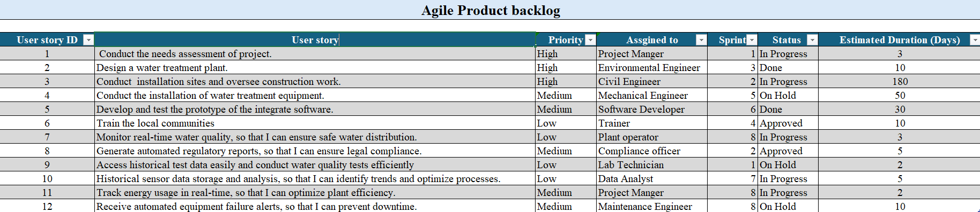
Product Backlog

Slide 9


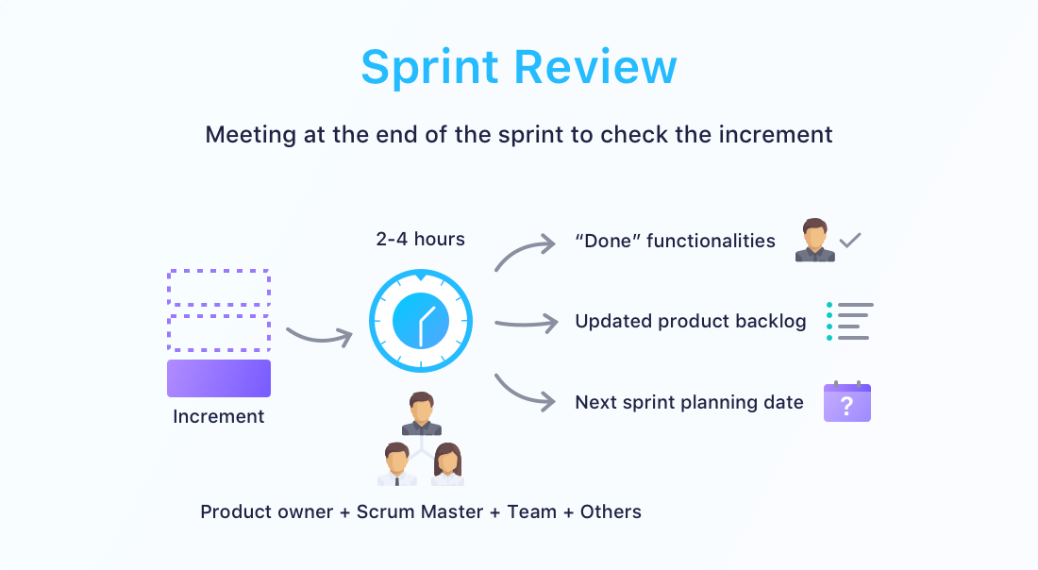
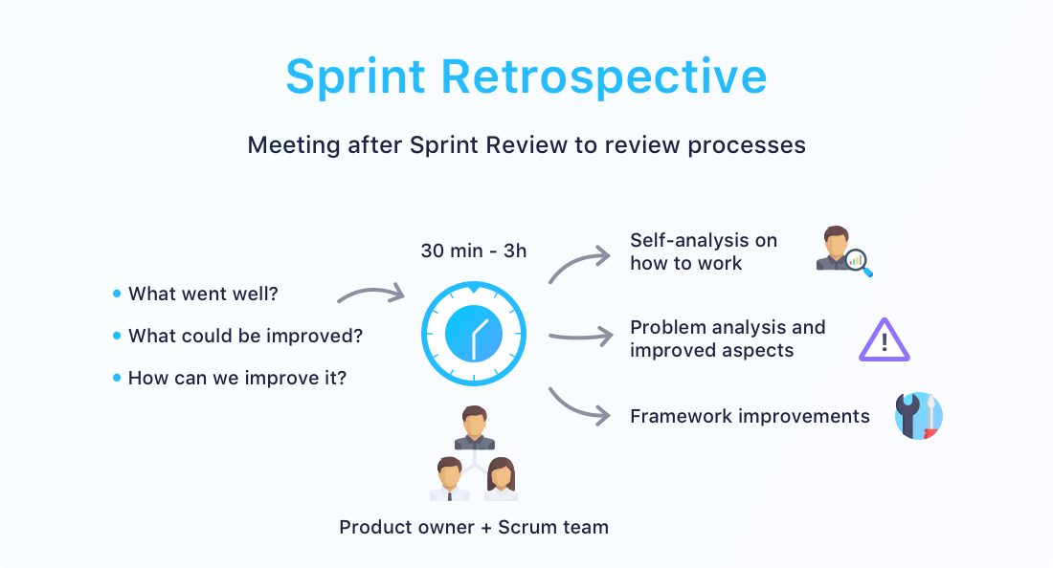
Sprint planning
Daily scrum
Sprint
1-4 weeks
Sprint Review
+ Sprint Retrospective
Product backlog
Sprint backlog
Finished product

Slide 10


Month 1 | Month 2 | Month 3 | Month 4 | Month 5 | Month 6 | Month 7 | Month 8
Documentation & Regulatory Compliance
Infrastructure setup
Technology Integration
Process Optimization
User training and Handover
Project start
Updating
Complete
In progress with update
In progress
Set up equipment & access site
Complete
Surveying & access
Developing Prototype
Monitor, refining & complete
Design
Checking steps
Analysing & Testing
complete
Require training needs
Training
Complete
Approval
Complete

Slide 11

Cost Estimation
Feature | Estimated Cost (INR)
Infrastructure Setup | ₹12,50,00,000
Technology Integration | ₹7,50,00,000
Process Optimization | ₹5,00,00,000
Regulatory Compliance | ₹7,50,00,000
User Training & Handover | ₹2,50,00,000
Total Cost | ₹37,50,00,000

Slide 12

Cost Estimation Per Sprint
Feature | Estimated Cost (INR)
Infrastructure Setup | ₹85,00,000
Technology Integration | ₹65,00,000
Process Optimization | ₹30,00,000
Regulatory Compliance | ₹15,00,000
Miscellaneous & Contingencies | ₹10,00,000
Salaries (Engineers, Project managers etc.) | ₹30,00,000
Total Cost | ₹2,35,00,000

Slide 13




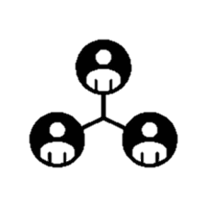
Risk Management & Mitigation
Regulatory Delays
Budget overuns
Technical Challenges
Stakeholder Misalignment

Slide 14
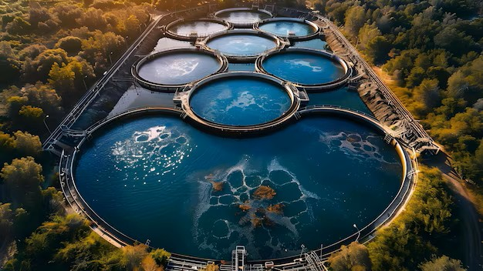


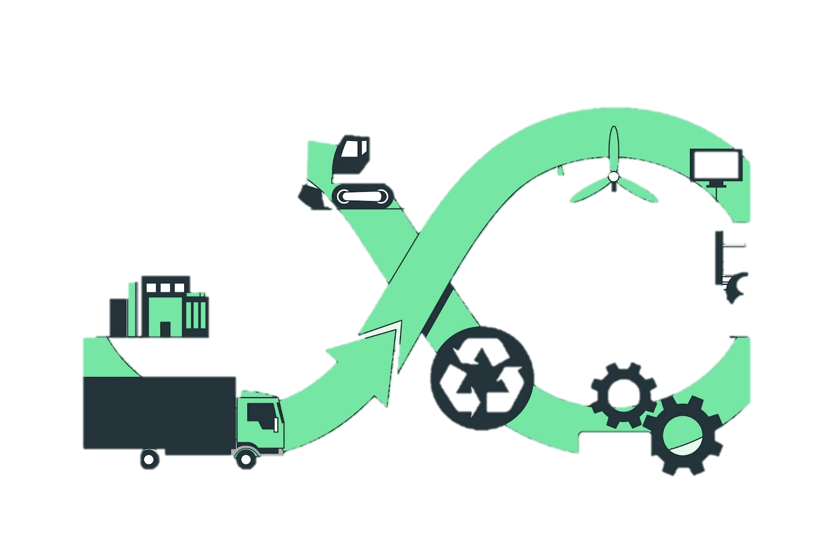
Conclusion
Agile Approach Ensures Flexibility & Efficiency
Cost-Effective & Scalable Solution
Ensuring Quality, Compliance & Sustainability
Safe Water Innovation Sets a New Benchmark – A sustainable and technologically advanced wastewater treatment solution that drives environmental and operational excellence. This project will significantly improve public health and environmental sustainability, showcasing our commitment to innovative solutions and positive community impact.

Slide 15
Q&A

